Slide 1
SLCL New Faculty Orientation September 8, 2023
Human Resources
Mariah Redmon, Assistant Director of Human Resources
Dana McCool, Human Resources Associate
Jennifer Jenkins, Business & HR Associate
07/18/2020

Slide 2
Presentation Outline
Onboarding
Offboarding
Benefits/Leaves
Systems and Tools
Appointments- Hiring Student Employees
Visa Process
Service in Excess/Summer Salary
FAQs/Resources

Slide 3
Onboarding

Slide 4
Human Resources Onboarding
Hiring New Employees Including Students – Important Information
All new hires are required to complete a federally required I9 form to prove employment authorization. This process must be completed before or on the first day of employment.
All new hires will need to provide identification documents from this list.
Provost Communications
Cornerstone/JDXpert
Faculty Hires
Board of Trustee packets
Specialized Faculty

Slide 5
UI New Hire Forms
Within 30 days:
Make your benefits selections online at www.MyBenefits.illinois.gov. (Benefits Eligible Employees). NOTE: You will need your CMS Employee ID# for this.
Complete the remainder of your forms in UI New Hire including Ethics Training (if not already done). NOTE: If Direct Deposit is not completed within 30 days, you will be issued your pay on a pay card. https://www.hr.uillinois.edu/pay/directdeposit/paycard)
OPTIONAL: Begin reviewing retirement plan options and attend a State Universities Retirement System (SURS) Webinar. Register at https://www.surs.org/plan-choice-webinar-tier-ii
Within 90 days:
Complete Title IX Training in UI New Hire (if not already done).
Within 6 months:
Select a SURS retirement plan (if not already done) or you will automatically be enrolled in the Traditional Benefit Package; this default enrollment is irrevocable.

Slide 6
Payments/Tax Forms
My UI Info:
https://www.hr.uillinois.edu/myinfo
Compensation Tab
Provide bank information
Access earnings statements
Provide tax withholding information (W-4) US citizens ONLY
Non-Resident Aliens cannot fill out the W-4.*
To contact the Social Security Administrative Office: https://www.ssa.gov/agency/contact/. Upon receipt of your SSN, please make a Tax Status Review appointment with Payroll. Be sure to bring a completed Foreign Nation Tax Information Form (on registration page), as well as originals and copies of all listed documentation.

Slide 7
Pay Dates
Pay dates are on the 15th of every month
Appointment dates are 8/16/23 - 5/15/24 for the academic year
Fall: Aug. 16, 2023–Dec. 31, 2023
Spring: Jan. 1, 2024–May 15, 2024
Notes:
Last pay check for fall appointment: Dec 16-31 (½ of month) will be paid out on 1/16 of the following year

Slide 8
Offboarding

Slide 9
Separations/Retirements
Employees need to submit an email announcing the plan to resign and the effective date to the manager and HR
The last day needs to be at the end of the month for benefits continuation purposes
Employees must complete an exit checklist and send to HR

Slide 10
Benefits/Leaves

Slide 11
Benefits
Employee Benefits Information Shared Benefits – donate a vacation or sick day to a pool, then the pool can be used by anyone that has donated, if they run out of vacation or sick time when a disability claim is pending before the State Universities Retirement System (SURS) or when experiencing a catastrophic injury or illness.
Employee & Child of Employee Tuition Waivers - provides information on college tuition and service fee waivers available to eligible University employees and their children. Select the appropriate link below to review the policy information and eligibility requirements.
Additional information on benefits can be found here:
https://slcl.illinois.edu/system/files/2023-04/New%20Employee%20Resources.pdf

Slide 12
Leaves
FMLA:
https://www.hr.uillinois.edu/leave/fmla/
Parental:
https://www.hr.uillinois.edu/leave/parental/
Sick Leave:
https://www.hr.uillinois.edu/cms/One.aspx?portalId=4292&pageId=5634
Paid/Unpaid/Other Leaves
https://www.hr.uillinois.edu/leave

Slide 13
Systems and Tools

Slide 14
Systems and Tools
System/Tool | Also called | What is it used for?
Human Resources Front End | HRFE | HR information systems (HRIS). HRFE stores all the HR related information about employees including personal information, work appointments and the CFOPS (accounts) to charge.
Applied Technologies for Learning in the Arts and Sciences | ATLAS | Appointment work-flow system and vacation and sick leave reporting tool
Banner Administrative Forms | Banner | In HR used for sick leave confirmation and reporting.
Payroll Adjustment Request Interface System | PARIS | Used to process pay adjustments, when jobs/appointments apply late.
Adjustment Notification Application | ANA | Used to process overpayments, awards and some retirement payments.

Slide 15
Systems and Tools
System/Tool | Also called | What is it used for?
Tracker Electronic I-9 | Tracker | Used to complete the federally-required employment authorization form (Form I-9)
Salary Planner | SPA | Used to submit annual merit increases and CMER adjustments
TimeTracker | Electronic Timesheet submission | Used to submit and approve timesheets for bi-weekly employees
International Scholars and Student Services | ISSS | Provides support for many different types of visa applications and extensions. Also provides information to foreign national student and scholars
JDXpert/Cornerstone Administrative Application | Applicant Tracking System | Used to track all searches, promotions, administrative stipends, and 0% appointments

Slide 16
Appointment Information for Hiring Student Employees

Slide 17
Appointments
HR Schedule/Deadlines
Fall deadlines
Submit appointment requests by beginning of June
Offer letters sent by July 15
Spring deadlines
Submit appointment requests by beginning of November
Offer letters sent by December 1
Summer deadlines
Submit appointment request by end of April for summer I, mid May for Summer II.

Slide 18
Appointments
Full Time Equivalencies (FTE)
SLCL uses an Academic Year average
Ex. A student has 2 courses in the fall and 1 in the Spring. What is the FTE?
Limitations to Employment
Foreign National can hold
Up to 50% appointment during the AY
Up to 67% appointment during breaks if enrolled in classes, 100% if not
US citizens can hold
Up to 67% during the AY unless on fellowship, then 50%
Up to 67% during breaks if enrolled in classes, 100% if not
Tuition Waivers, Fees and Taxation

Slide 19
Assistantship and Graduate Hourly Duties
There are four types of graduate assistantships: Research Assistant (RA), Pre-Professional Graduate Assistant (PPGA), Teaching Assistant (TA) and Graduate Assistant (Administrative).
TAs and GAs are covered by a collective bargaining agreement with the Graduate Employee Organization (GEO). GEO determines appointment terms, wages, fee waivers, health care, childcare, and tuition waivers.
Hourly positions- undergraduate & graduate (non-tuition waiver appointments)/TimeTracker
Please be descriptive when filling out appointment forms (e.g., major duties and responsibilities)
Assistantship definitions can be found here: https://humanresources.illinois.edu/supervisors/labor-and-employee-relations/frequent-areas-of-interst/performance-management/Grad-Asst-Definitions.html
Graduate Employee Information: http://humanresources.illinois.edu/employees/current-employees/graduate-employees/graduate-assistant/index.html
Additional resources for hiring student employees can be found here: https://slcl.illinois.edu/system/files/2022-08/New%20Faculty%20Resources.pdf

Slide 20
Appointments
Rates for 2023-2024 for all assistantship appointments*
Monthly rate is what the student is paid
Rate plus Fringe is what your account gets charged
The 2023-2024 Academic Calendar is split Fall: 4.47619048/ Spring: 4.523809523 months each
FTE | Monthly Rate (campus minimum) | Monthly Rate plus Fringe | Fall Only plus Fringe (8/16-12/31) | Spring Only plus Fringe (1/1-5/15) | AY plus Fringe (8/16-5/15)
67% | $3,287.47 | $3,609.97 | $16,158.90 | $16,330.80 | $32,489.70
50% | $2,453.33 | $2,694.00 | $12,058.88 | 12,187.17 | $24,246.04
33% | $1,619.20 | $1,778.04 | $7,958.86 | $8,043.53 | $16,002.39
25% | $1,226.67 | $1,347.00 | $6,029.44 | $6,093.58 | $12,123.02
17% | $834.13 | $915.96 | $4,100.02 | $4,143.64 | $8,243.66

Slide 21
Appointments
Workflow
Faculty submits the monthly pay online form or the hourly online form.
Linguistics and Spanish appointments: provide the information directly to your Office Manager (copy SLCL HR office)
Office Manager creates the appointment in ATLAS
Business Office approves the CFOP

Slide 22
Appointments
Workflow
HR office:
Confirms the FTE is within the limitations to employment
Confirms the position descriptions match the title
Sends offer letter to the student
Updates the supervisor field
Student accepts or declines the offer
HR enters the appointment for accepted offers in HRFE and routes to the college
If the student has a fellowship it first routes to that department
College routes to campus
Campus approves the appointment and “applies” it which enters it in Banner.

Slide 23
Visa

Slide 24
Visas
Student Visas
F-1
J-1
Visiting Scholar Visas
J1
Employment Visas
J-1 Requires 2 yr. home residency requirement
OPT Student that has graduated recently – completed by the student
H1B File up to 3 yr. commitment that can be reapplied for reaching a maximum of 6 yrs. A minimum of 3 months to complete the application if no issues arise. Each issues will extend the application process.

Slide 25
Service In Excess (SIE)

Slide 26
Service in Excess (SIE) and Lump Sum Payments
Paid for overload teaching or for other special projects or assignments normally outside an employee’s routine responsibilities after the service is performed.
Overload is defined as teaching duties performed over and above the employee’s normal required teaching load
All necessary approvals must be obtained prior to services being performed.
All fields must be completed or the form will be returned

Slide 27
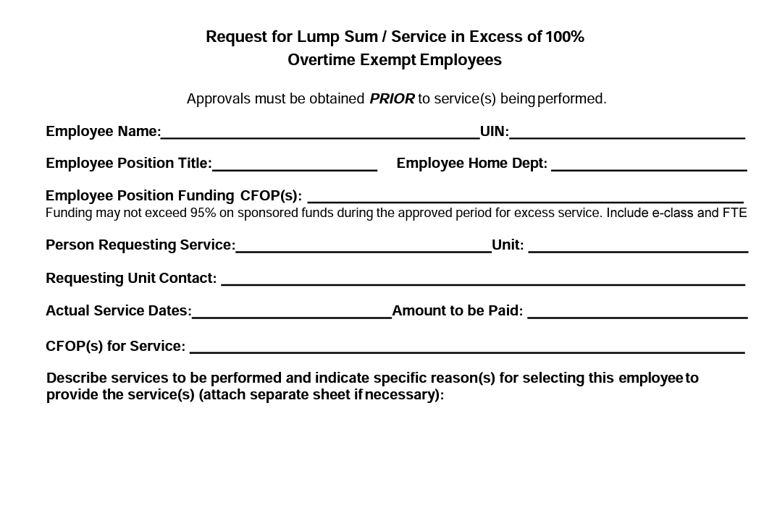
Service in Excess (SIE) and Lump Sum Payments

Slide 28
Service in Excess (SIE) and Lump Sum Payments
Workflow
Faculty member completes the top portion of the form, filling in all fields.
The completed form is sent to SLCL HR for routing
Approvals are obtained from the following units:
Requesting Unit, College; home unit and college, Director of SLCL, IHR (if over $5,000)
All fields must be completed or the form will be returned

Slide 29
Summer Salary

Slide 30
Summer Salary
Summer Salaries
Summer salaries will be approved by EO prior to adding into HRFE
Summer salaries are to be requested on the SLCL site in the Summer Salary form
https://slcl.illinois.edu/resources/faculty-and-staff-resources/human-resources-forms-and-information/faculty-and-staff
Needs to be completed by April 15th
If other than 1/9th of salary you will need to add the amount and then it will be reviewed by your EO before processing.

Slide 31
Questions?
Welcome to the
University of Illinois!!!
Best wishes toward a
rewarding academic adventure!!!

Slide 32
Human Resources
HR website
HR FAQs

Slide 33
Campus Resources
Annual Security Report at https://police.illinois.edu/clery/ (Campus crime statistics and campus security information
Campus Holiday Schedule at https://humanresources.illinois.edu/employees/resources/info-about-your-employment/campus-holiday-schedule.html
Campus Recreation at https://campusrec.illinois.edu
Shared Benefits Program at https://www.hr.uillinois.edu/leave/sharedbenefits/
Smoke-Free Campus Policy at https://tobaccofree.illinois.edu/
Obtain a University ID Card (Urbana ID Center, Illini Union Bookstore, First Floor, 809 S Wright Street, Champaign) https://www.icardnet.uillinois.edu/public/urbana-idc.cfm
Establish parking arrangements if needed (Parking Department, 1201 W University Ave, Urbana, 217-333-3530) Web page: http://www.parking.illinois.edu Email: parkingcomments@illinois.edu
Register for a Benefits Orientation and optional Benefits Enrollment Session (only for benefits-eligible employees) https://www.obfs.uillinois.edu/training/registration

