Slide 1
SLCL New EO Orientation August 25, 2023
Human Resources
Mariah Redmon, Assistant Director of Human Resources
Dana McCool, Human Resources Associate
07/18/2020

Slide 2
HR TEAM
Mariah Redmon, Assistant Director of Human Resources
mredmo2@illinois.edu
217-300-8591
Dana McCool, HR Associate
dmccool@illinois.edu
217-300-5811

Slide 3
Presentation Outline
Search Guidelines
Onboarding/Offboarding
Appointments
Service in Excess
FAQs/Resources

Slide 4
Searches
EO responsibilities:
Provide the charge for the search
Understand the Pre-search and Search process
Serve as a resource to the department and search committees

Slide 5
Searches
Resources:
SLCL Search Timeline Planner
Diversity Training : must be current to participate on a search
JDXpert-Cornerstone (illinois.edu)
Hiring Request Form & Search Information Form must be completely filled out in order to submit for approval

Slide 6
Searches
Specialized Faculty Search Resources
Pre-search process
Overview of Search Procedures
Evaluation Criteria and Interview Questions
Campus Salary Minimums
Additional Resources

Slide 7
Onboarding

Slide 8
Human Resources Onboarding
Hiring New Employees Including Students – Important Information
All new hires are required to complete a federally required I9 form to prove employment authorization. This process must be completed before or on the first day of employment.
All new hires will need to provide identification documents from this list.
Provost Communications
Cornerstone/JDXpert
Faculty Hires
Board of Trustee packets
Specialized Faculty

Slide 9
Offboarding

Slide 10
Separations/Retirements
Employees need to submit an email announcing the plan to resign and the effective date to the manager and HR
The last day needs to be at the end of the month for benefits continuation purposes
Employees must complete an exit checklist and send to HR

Slide 11
Appointments

Slide 12
Appointments
HR Schedule/Deadlines
Fall deadlines
Submit appointment requests by beginning of June
Offer letters sent by July 15
Spring deadlines
Submit appointment requests by beginning of November
Offer letters sent by December 1
Summer deadlines
Submit appointment request by end of April for summer I, mid May for Summer II
GEO Contract
Determines appointment terms, wages, fee waivers, health care, childcare, and tuition waivers.

Slide 13
Appointments
Full Time Equivalencies (FTE)
SLCL uses an Academic Year average
Ex. A student has 2 courses in the fall and 1 in the Spring. What is the FTE?
Limitations to Employment
Foreign National can hold
Up to 50% appointment during the AY
Up to 67% appointment during breaks if enrolled in classes, 100% if not
US citizens can hold
Up to 67% during the AY unless on fellowship, then 50%
Up to 67% during breaks if enrolled in classes, 100% if not

Slide 14
Appointments
Tuition Waivers, Fees and Taxation
Teaching Assistant
Graduate Assistant
Research Assistant
Grad Hourly

Slide 15
Appointments
Rates for 2023-2024 for all assistantship appointments*
Monthly rate is what the student is paid
Rate plus Fringe is what your account gets charged
The 2023-2024 Academic Calendar is split Fall: 4.47619048/ Spring: 4.523809523 months each
FTE | Monthly Rate (campus minimum) | Monthly Rate plus Fringe | Fall Only plus Fringe (8/16-12/31) | Spring Only plus Fringe (1/1-5/15) | AY plus Fringe (8/16-5/15)
67% | $3,287.47 | $3,609.97 | $16,158.90 | $16,330.80 | $32,489.70
50% | $2,453.33 | $2,694.00 | $12,058.88 | 12,187.17 | $24,246.04
33% | $1,619.20 | $1,778.04 | $7,958.86 | $8,043.53 | $16,002.39
25% | $1,226.67 | $1,347.00 | $6,029.44 | $6,093.58 | $12,123.02
17% | $834.13 | $915.96 | $4,100.02 | $4,143.64 | $8,243.66

Slide 16
Appointments
Workflow
Faculty submits the monthly pay online form or the hourly online form.
Linguistics and Spanish appointments: provide the information directly to your Office Manager (copy SLCL HR office)
Office Manager creates the appointment in ATLAS
Business Office approves the CFOP

Slide 17
Appointments
Workflow
HR office:
Confirms the FTE is within the limitations to employment
Confirms the position descriptions match the title
Sends offer letter to the student
Updates the supervisor field
Student accepts or declines the offer
HR enters the appointment for accepted offers in HRFE and routes to the college
If the student has a fellowship it first routes to that department
College routes to campus
Campus approves the appointment and “applies” it which enters it in Banner.

Slide 18
Courtesy Appointments

Slide 19
Emeritus/Emerita Requests
Communication 12: Policy for Awarding Emeritus/Emerita Status
The department initiates the request for emeritus status
To initiate the process:
Complete the transmittal form
Submit a letter to provide the rationale for the status
This is submitted to the College for review and approval.
The Provost will provide a letter to the faculty member to provide an update on the request.

Slide 20
Zero Percent Appointments
Criteria
Communication 3: Appointments of Faculty, Specialized Faculty, and Academic Professionals
Faculty, Instructor, or Academic Professional with an appointment on UIUC campus or equivalent rank
That the individual possess legitimate qualifications for appointment to the faculty and the collaboration will enrich the academic mission of the department/program.
That he or she will make identifiable contributions to the nominating unit; that he/she expresses a desire and willingness to substantially collaborate with faculty in the appointing department/program.
Any specific expectations associated with the appointment should be addressed in writing.

Slide 21
Zero Percent Appointments
Procedure
A faculty member writes a nomination, addressing the criteria above and recommending either a permanent zero percent appointment or a two-year renewable appointment.
The unit’s Executive (or Advisory) committee advises the EO on the appropriateness of the appointment and whether it should be a permanent appointment or two year renewable appointment.
The EO recommends the extension of a zero-time appointment to the full faculty. The faculty as a whole vote on the extension of privileges.
The written request and recommendation (including faculty vote) is forwarded to the Director of the School and the Dean of the College, for official approval.
If the appointment is renewable, by May 15 of the second full academic year after the appointment starts, the affiliated faculty member writes a letter to EO requesting continued appointment and describing his or her continued engagement with the unit. The unit’s Executive Committee advises the EO, and a decision is made on whether or not to continue affiliated faculty’s appointment.
If no letter is received from the affiliated faculty member, the appointment automatically terminates.

Slide 22
Zero Percent Appointments
Procedure
A faculty member writes a nomination, addressing the criteria above and recommending either a permanent zero percent appointment or a two-year renewable appointment.
The unit’s Executive (or Advisory) committee advises the EO on the appropriateness of the appointment and whether it should be a permanent appointment or two year renewable appointment.
The EO recommends the extension of a zero-time appointment to the full faculty. The faculty as a whole vote on the extension of privileges.
The written request and recommendation (including faculty vote) is forwarded to the Director of the School and the Dean of the College, for official approval.
If the appointment is renewable, by May 15 of the second full academic year after the appointment starts, the affiliated faculty member writes a letter to EO requesting continued appointment and describing his or her continued engagement with the unit. The unit’s Executive Committee advises the EO, and a decision is made on whether or not to continue affiliated faculty’s appointment.
If no letter is received from the affiliated faculty member, the appointment automatically terminates.

Slide 23
Service In Excess (SIE)

Slide 24
Service in Excess (SIE) and Lump Sum Payments
Paid for overload teaching or for other special projects or assignments normally outside an employee’s routine responsibilities after the service is performed.
Overload is defined as teaching duties performed over and above the employee’s normal required teaching load
All necessary approvals must be obtained prior to services being performed.
All fields must be completed or the form will be returned

Slide 25
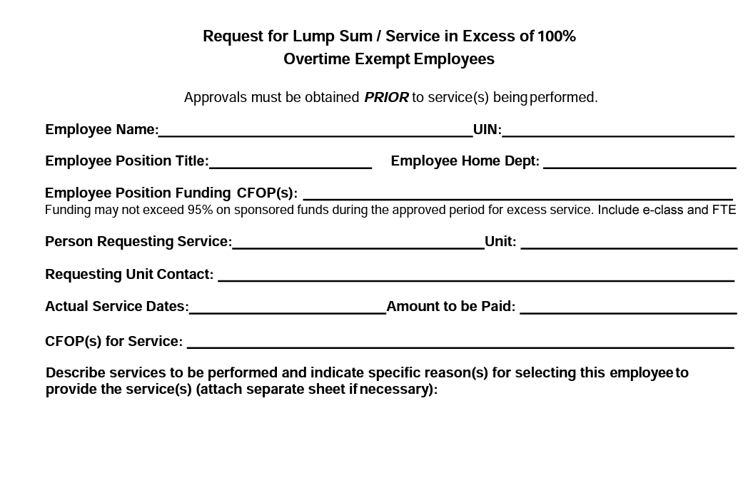
Service in Excess (SIE) and Lump Sum Payments

Slide 26
Service in Excess (SIE) and Lump Sum Payments
Workflow
Faculty member completes the top portion of the form, filling in all fields.
The completed form is sent to SLCL HR for routing
Approvals are obtained from the following units:
Requesting Unit, College; home unit and college, Director of SLCL, IHR (if over $5,000)
All fields must be completed or the form will be returned

Slide 27
Human Resources
HR website
HR FAQs

