Slide 1
Introduction to FSAS Services The Needs of the Work Group
IHR-Faculty/Staff Assistance Services
Morris Mosley LCSW Work Group Specialist Faculty-Staff Assistance

Slide 2
Problem-Solving and Problem-Reconciliation
Problem-Solving
Group Process
Individual Process
Emotions
Your unique perceptions
It’s About All of Us
(group centered)
It’s About Me (self-centered)
Avoidance
(fear of conflict)
Past Trauma
(boundaries)
Competing Process
Seeking Solution
It’s Win-Lose (face-saving)
Anger
(other’s)
Implicit Bias
(learning & behavior)
Obstacles
Improving Working Relationships
It’s Adversarial (diminish others)
Entitlement (most deserving)
Culture
(perspective)
Life Experiences
Collective
Choice
Ownership
Self-awareness

Slide 3
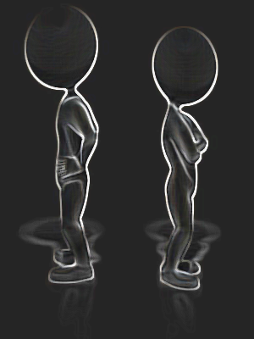
The Development of Problem-Solving Skills
Childhood Conflict
Adolescent Conflict
Adult Conflict
We seek resolution by adult intervention
We seek resolution through power
We seek solutions
Dependency
Frustration
Concrete thinkers
Egocentric
Win-Lose
Power-struggle
My way
Self-absorbed
Common Ground
Collaboration
Compromise
Innovation

Slide 4
Specific: Problem-Solving Paths & Obstacles
Process
Motivation
Emotions
Behavior
Solution
Direct Resolution
Curiosity
Engagement
Blame
Direct Fault
Avoidance
Accusatory
Parent/Child
Redirect Ownership
Innocence
Helplessness
Self-Serving
My Agenda
Entitlement
Controlling

Slide 5
Presenting Behavior
Underlying Need
Presenting
Behavior
Underlying Need
Conflict-Avoidance
Problem-solving skills
Anger Management
Coping with Emotional Pain
Micro-managing
Leadership Skills
Frustration Tolerance
Anticipated Loss
Approval-Seeking
Self-definition
Fear and Anxiety
Anticipated Pain
Avoidance of responsibility
Owning Choices
Controlling Behaviors
Fear of Losing Control
Intolerance of Imperfection
Self-Acceptance
Bullying
Fear of Inadequacy
Bias
Self-awareness

Slide 6
Problem-Solving: A Workplace Model
Conflict/ Problem
Problem Solving (process)
Accountability
Event
Learning
Self-
Awareness
Decision-Making
Outcomes
Focus on the event (not the participants)
Focus on expanding knowledge base
Focus on ownership (my role in the problem
Focus on
choices ( not compelled)
Learning from one’s own experience

Slide 7
Understanding the Complications of Conflict-Avoidance
Conflict/ Problem
Problem Solving (process)
Accountability
Event
Learning
Outcomes
Avoid Conflict
Self-
Awareness
Decision-Making
Direct Fault
Accuse
Conflict-Avoidance/Blame

Slide 8
Understanding the Complications of Conflict-Avoidance
Conflict/ Problem
Problem Solving (process)
Accountability
Event
Assume or Redirect Ownership
Learning
Decision-Making
Outcomes
Self-
Awareness
Helplessness
Assume Responsibility or Claim Innocence
Parent/Child Rapport

Slide 9
Understanding the Complications of Conflict-Avoidance
Conflict/ Problem
Problem Solving (process)
Accountability
Event
Learning
Outcomes
My Agenda
Decision-Making
Self-
Awareness
Controlling Behavior
Entitlement
Self-Serving

Slide 10
Problem Solving Strategies
Common ground is the overlap between the positions of parties that may otherwise disagree. "Finding common ground" is a technique used to facilitate interpersonal relationships.
Win-Lose
When choosing this strategy, one takes on an adversarial or competitive view. The focus is on achieving immediate goals, with little or no regard for building future relationships.
Compromise is an agreement or a settlement of a dispute that is reached by each side making concessions.
Innovation is the creation and transformation of new knowledge into new products, processes, or services that meet public demand. As such, Innovation is a potential outcome of all efforts to reach resolution. Innovation is also a survival method.
Collaboration is the action of working with someone to produce or create something.

Slide 11
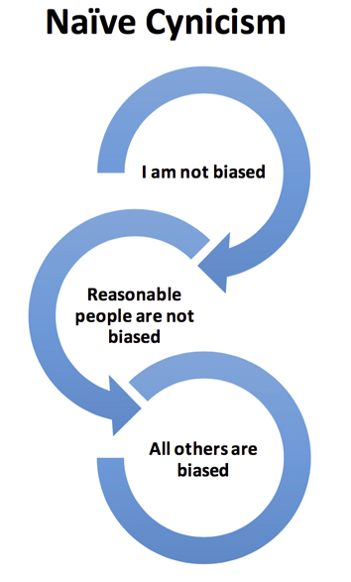
Influencing Our Perception of Conflict:
The Acknowledgement of Bias
Naive cynicism is our belief that we see the world as it really is. Although we often don't believe that our judgements are biased, we readily recognize that the judgment of others may be biased.

Slide 12
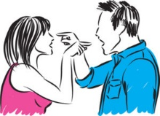
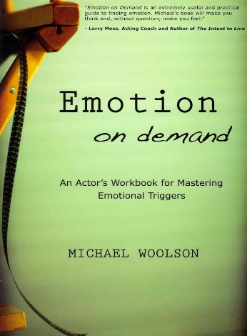
In many difficult situations, feelings are the heart of the matter.
When our needs are threatened, emotions are triggered.
Unexpressed feelings may take the form of sarcasm, passive aggression, impatience, etc.
Feelings
The sooner you notice an emotion is triggered, the sooner you can discover if the threat is real or perceived.

Slide 13
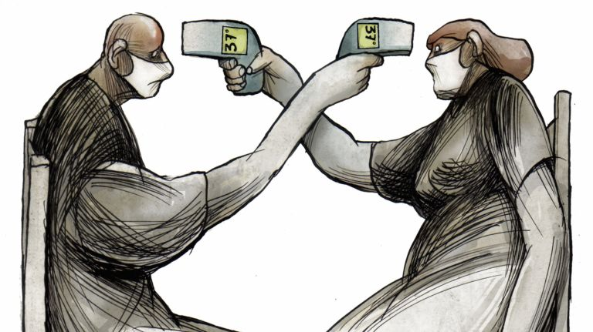
Emotional Triggers
Needs
Inclusion
Attention
Approval
Health

Slide 14
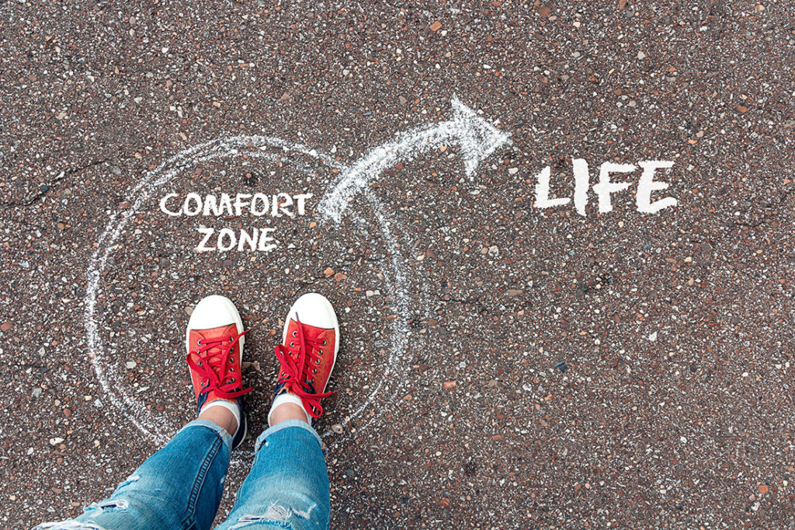
Emotional Triggers
Needs
Control
Comfort
Independence
Acceptance

Slide 15
Emotional Triggers
Needs
Control
Engagement
Justice
Safety

Slide 16
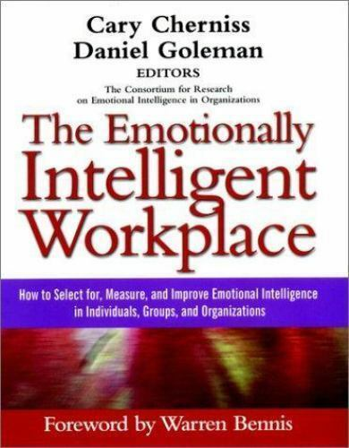
Rebuilding Groups and Collective Influence
“Group Emotional Intelligence
is the ability of a group to generate a shared set of norms that manage the emotional process”
If your group could generate one norm intended to influence your shared work environment, what would it be?

Slide 17
What is collective influence?
Individual Influence
Competitive Influence
Collaborative Influence
Collective Influence

Slide 18
Fear: Conflict
Group Dynamics
Fear: Loss of Significance
Fear of Retaliation
Fear
Frustration
Interface
Repression
Interface
Passive- Aggression
Loss-Problem Solving
Power-Struggle
Denial of ownership
Anger
Avoidance of conflict
Fear: Loss of Approval
Fear: Futility
Loss of Voice
Intolerance of Imperfection
Hopelessness
Interface
Enabling
Interface
Coping
Avoidance of Disapproval
Indifference
Perception of Incompetence
Job search-Exit

Slide 19
Rebuilding Group Identity :Establishing Shared Norms
Change Agent
Meaning
Feeling purposeful or a part of something bigger than self
Accomplishment
Feeling a sense of achievement, creation, or contribution
Positive Emotion
Feeling joy, hope, excitement, satisfaction
Wellness
Feeling comfortable in your own skin
Finding individual value and collective worth
The advantages of diverse groups
The instillation of Hope
Engagement
Feeling content in the present moment
The need for inclusion
The need for acceptance
Expressing feelings along with thoughts
Acceptance
Feeling a sense of belonging and support from others
Norm for group engagement
The challenge of diversity
Building group trust

Slide 20
Growth and Behavior
Human Development
Clarifying
Beliefs
Social Learning
Behavior is developmentally appropriate
Immaturity
Rigidity
Life
Experience
Delays (opposition)

Slide 21
Growth and Beliefs
Behaviors results from an acceptance of responsibility for behavior
An awareness of responsible behavior
Human Development
An awareness of existing beliefs
Clarifying
Beliefs
Social Learning
Owning choices
Behaviors result from developmentally appropriate responses
immaturity
rigidity
Life
Experience
delays

Slide 22
Beliefs and Life Experience
Behaviors results from acting on accepted beliefs
Human Development
An awareness of expectations
Clarifying
Beliefs
Social Learning
An awareness of existing beliefs
Explicit Bias
Behavior results from our perception of life events
Implicit Bias
Cultural Norms
Life
Experience
The Impact of Trauma

Slide 23
Influencing Learned Behavior
Human Development
Clarifying
Beliefs
Social Learning
Behaviors result from developmentally appropriate responses
Behavior results from beliefs surrounding life events
immaturity
Implicit Bias
rigidity
An awareness of culture
delays
An awareness of emotional triggers (Anger, PTSD, Childhood Trauma)
Life
Experience

Slide 24
Influencing Workplace Culture
Accountability encourages decision making
Ownership improves coping behaviors
Learning encourages new behavior
IHR Title IX
OEA Ethics
Human Development
Policy education
Clarifying
Beliefs
Social Learning
Corrective action
Policy remediation
Learning and Development
EAP
Accountability
Education
Counselling
Social learning
Mediation
Skill-building
Life
Experience
Group process
Coaching Professional Growth
Coaching
Personal Growth

Slide 25
Services Related to Learning New Behaviors
Services for the Individual
Services for Working Groups
Coaching
How can I improve my work?
How can I encourage professional development?
Services Presentation
Methods of Group Problem-Solving
Counseling
How can I improve my self-awareness?
How do I encourage personal growth?
Topic-Driven Presentation
Group Education: Learning and Behavior
Mediation
What is my understanding of conflict?
What are my methods of problem-solving?
Skill-Building Presentation
Group Problem-Solving Methods

Slide 26
Services Related to Examining Beliefs
Services for the Individual
Services for Working Groups
Coaching
How can I improve my work?
How can I encourage professional growth?
Process Group Discussion
Methods of Improving Self-awareness
Counseling
How can I improve my self-awareness?
How do I encourage personal growth?
Focus Group Discussion
Method of Improving Collective awareness
Mediation
What is my understanding of conflict?
What are my methods of problem-solving?
Group Series
Method of Rebuilding Group Norms
Method of Establishing Group Identity

