Slide 1

Graduate Employee Orientation
August 28, 2026
Human Resources
Mariah Redmon, Assistant Director of Human Resources
Dana McCool, Senior Human Resources Generalist
Meghan Yearta, Human Resources Generalist
08/25/2026

Slide 2
HR Presentation Overview
Employment Information
Compensation
Tuition Waivers
Healthcare & Benefits
Leaves
Other Important Information

Slide 3
Employment Information

Slide 4
Types of Assistantships
Administrative Grad Assistant
  Support of administrative functions
Pre-Professional Grad Assistant
  Primarily gain experience, practice, or guidance that is significantly connected to their fields of study and career preparation
Research Assistant
  Primarily involve applying and mastering research concepts, practices, or methods of scholarship.
Teaching Assistant
  Primarily in support of instruction

Slide 5
Terms of Assistantship Appointment
Renewal of Appointments
Renewal decisions are made by the appointing unit
Units are encouraged to confirm plans at least 30 days before the Fall/Spring appointment begins
Resignation
Assistants are required to give a 14-day notice of resignation
Written release from the appointing unit is required to accept an assistantship in another unit
Termination
May occur if the assistant fails to enroll, maintain academic eligibility, or withdraws from the University
May also occur for disciplinary reasons, following established procedures

Slide 6
What comes with an Assistantship?
Monthly stipend
Tuition and fee waivers
University pays 100% for coverage through McKinley Health Center and Counseling Center
Individual Health Insurance: The University will contribute 87% of the coverage
Dependent Health Insurance: The University will contribute 40% of the coverage, if elected
University paid dental and vision insurance coverage
Sick leave
Holidays
Notes:
Health Care- The University will contribute 87% per semester (fall, spring, summer) of the Student Health Insurance Fee for any assistant holding an assistantship who chooses to be covered by the University plan. The University will also cover 40% per semester of the cost of one dependent. Info found here: Contract — Graduate Employee's Union Organization at UIUC (uiucgeo.org)

Slide 7
Limitations to Employment
International Students can hold
  Up to 50% appointment during the AY
US citizens/Permanent Residents/EAD can hold
  Up to 67% during the AY. Note: The Graduate College has raised its limit on concurrent employment for fellowship holders from 50% to 67%, and Grad Hourly positions will no longer count toward the limit. (Note, however, that any lower limits set by funders, departments, government agencies, etc. will still apply.)
Breaks (Fall, Winter, Spring)- May work additional hours in break periods when classes are not in session. EXCEPTION: Summer - if a student is enrolled in classes – the maximum percentage is 67% (fellowships excluded)
Notes:
Foreign nationals cannot work over 50% - for any reason – this will jeopardize your visa status!
U.S. Citizens cannot work over 67% - for any reason
PR card holders cannot work over 67%
EAD cannot work over 67% - for any reason
Loss of tuition waiver

Slide 8
Tax Forms
U.S Citizens must fill out the W-4.
International students classified as non-residents for tax status purposes should not fill out the W-4.
How to apply for a social security number (SSN): https://isss.illinois.edu/resources/apply_ssn.html
Contact the Social Security Administrative Office at https://www.ssa.gov/agency/contact/
Upon receipt of your SSN, please make a Tax Status Review appointment with Payroll. Additional information can be found here: Payments to Foreign Nationals - Business & Finance
Notes:
If this is not filled out you will not have the proper taxes withheld from your paycheck
If you are a Non-resident alien you CANNOT fill out the W-4 form. A tax information session will be available at a later date – an e-mail will be sent MUST HAVE SSN CARD FIRST

Slide 9
GEO
What is the GEO? The labor union that represents teaching, research and graduate assistants
  https://www.uiucgeo.org/
Employees are not required to join the union
Dues deduction determined by the GEO
GEO contract determines minimum salary
More information can be obtained at the “all campus orientation”
Notes:
GEO is a union that represents the graduate assistant classifications of TA and GA
Employee: To perform duties as assigned, timely notification (14 days) if resigning or have conflicts in schedules, attend department/unit meetings, to communicate/plan with your supervisor any absences in advance (if possible)
Employer: provide access to office, lab, etc., mailbox if employed in unit, supplies to fulfill the duties of your job, to clearly state what duties you are assigned (although the dept may change the assignment of duties at their discretion – with notification to the employee)

Slide 10
Compensation

Slide 11
Stipend Payments
Must be paid via direct deposit
  New employees have 30 days to provide direct deposit information
  Failure to provide banking information results in pay being provided via paycard
My UI Info:
https://www.hr.uillinois.edu/myinfo
Pay Tab
Provide bank information for direct deposits
Access earnings statements
Provide tax withholding information (W-4) US citizens ONLY

Slide 12
Pay Dates
Pay dates are on the 16th of every month
  NOTE: Grad hourly appointments are paid Bi-weekly and must turn in a timesheet for payment
Appointment dates are 8/16/26 -5/15/27 for the academic year
Fall: Aug. 16, 2026 – Dec. 31, 2026
Spring: Jan. 1, 2027 – May 15, 2027
Assistantships are professional level appointments, percent time is not rigidly equivalent to hours/week
For example: 50% FTE assistant expected to provide an average of 20 hours/week over the course of the full appointment period
Notes:
Last pay check for fall appointment: Dec 16-31 (½ of month) will be paid out on 1/16 of the following year

Slide 13
Overtime Pay
Federal Labor Standards Act (FLSA) determines whether a position/employee is eligible to be paid overtime.
TA’s, RA’s, and PGA’s are FLSA exempt and therefore not eligible to receive overtime compensation
Administrative GA positions are FLSA non-exempt and eligible for overtime if more than 40 hours are worked in a single week
Required to keep record of actual hours worked

Slide 14
Tuition Waivers

Slide 15
Tuition Waiver Generating Assistantships
Student Status
  Must be degree-seeking student in good standing in academic program
Registration
  Required in Fall and Spring
  May be required by academic program in Summer
Full-Time Equivalent (FTE)
  Total Assistantship FTE 25 - 67%
Duration
  At least ¾ of academic term
  Fall/Spring: 91 days
  Summer: 41 days
  Summer I TA only: 21 days
  Academic Term = first day of classes through last day of finals

Slide 16
What is included in a waiver?
Tuition waivers
  Traditional programs can have base-rate or full waivers. It is dependent on curricula.
  Students in approved cost-recovery and self-supporting programs are not eligible to receive tuition & fee waivers except statutory waivers. However, students are eligible to receive tuition scholarships.
  Additional waiver information can be found in the Graduate College Handbook (Chapter 7) at: Handbook & Policies | The Graduate College at the University of Illinois at Urbana-Champaign
*If your appointment applies late, please contact financial aid at finaidwaivers@illinois.edu for information about the tuition waiver process
Notes:
Graduate College Handbook 2025 – 2026: Waiver-generating assistantship appointments are defined as appointments ranging from 25 percent through 67 percent time (based on a 40-hour week) for at least three-quarters of the academic term. The academic term is the period starting on the first day of classes and ending on the last day of final examinations. For fall and spring terms, three quarters is defined as 91 days. For summer term, it is defined as 41 days. A teaching assistant appointment between 25 percent and 67 percent for at least 21 days in Summer I (4-week part of summer term) will be considered a waiver-generating appointment. The tuition waiver policy for graduate assistantships is established by the campus, with certain provisions tied to the graduate program in which the student is enrolled (as identified by the graduate program code). Before units can elect to make any changes to their tuition waiver policy, they must seek and receive approval from the Graduate College and the Office of the Provost. Students are governed by the waiver policy in effect at the time of first enrollment in the program as long as they are in good academic standing and are making sufficient progress toward graduation in that program.

Slide 17
What is included in a waiver?
Fee Waivers
Academic Facilities Maintenance Fund Assessment (AFMFA) fee
Service fee
Library/ Information Technology fee
Transportation fee
International Student Fee (if applicable)
Office of the Registrar
  Fee Assessment Information
  https://registrar.illinois.edu/tuition-fees/fee-info/
Notes:
Fee waiver information found here: Contract — Graduate Employee's Union Organization at UIUC (uiucgeo.org)

Slide 18
Tuition waiver processing schedule
Tuition waivers are processed daily. Financial aid for the current academic term is disbursed to student accounts on Sunday and Wednesday evenings. Refunds are issued by the University Bursar the following business day.
Contact the Bursar’s office with questions about the waiver processing
bursarhelp@uillinois.edu
Access Refund Information: Log in to Student Self-Service with your NetID/password, verify your identity, then select University Bursar → Refund Information.
Notes:
Fall 2025 Tuition Waiver Processing Schedule | Office of Student Financial Aid | Illinois
Refunds - PAY MY BILL Home

Slide 19
Healthcare & Benefits Information

Slide 20
Health Care Information
McKinley Health Center
On-campus health center that provides a vast number of services including acute care, women's health, immunizations/vaccines, mental health services, primary care, and many others.
Scheduling Appointments: M-F 8AM- 5PM at 217.333.2700 or online MyMcKinley Portal
Fees & Dates: Health Service Fees, Dates, and Deadlines | McKinley Health Center | UIUC (illinois.edu)
Home | McKinley Health Center | UIUC (illinois.edu)

Slide 21
Health Care Information
Student Health Insurance
http://si.illinois.edu
May enroll dependents
Student Insurance Office
1109 S. Lincoln Ave. Urbana, IL (inside McKinley Health Center in the main lobby)
Dental & Vision
Assistants automatically enrolled
May enroll dependents
For more information and access to forms:
https://si.illinois.edu/benefits/dental-insurance-policy

Slide 22
Leaves

Slide 23
Leaves
Paid Sick leave
Maximum 13 non-cumulative days per year
6 ½ days per semester
Days are equal to your “work day” and not set at 8 hours
Example: 33% appointment of 13.2 hrs/wk = sick day of 2.64 hours
Tracked by supervisors/units
Parental Leave
6 weeks of paid leave immediately following birth or adoption
Leave shall not exceed 6 weeks in total
Available to both mothers and fathers
Must occur during active appointment period

Slide 24
Leaves
Funeral/Bereavement Leave
Up to 5 days paid leave upon death of:
Immediate family
Domestic partner
Civil union partner
Household member
In-laws
Grandparents and/or grandchildren
1 day paid leave upon death of:
Relative other than the above who is not a member of employee’s household
https://www.hr.uillinois.edu/cms/One.aspx?portalId=4292&pageId=5623#Other%20Provisions
Notes:
Employment Leaves- Assistants are eligible for holidays, sick leave, parental, and bereavement leave. Review the Illinois Human Resources website for additional information. Questions about leave policies should be directed to Illinois Human Resources: chrome-extension://efaidnbmnnnibpcajpcglclefindmkaj/https://grad.illinois.edu/sites/grad.illinois.edu/files/pdfs/handbook.pdf

Slide 25
Leaves
Family Medical Leave Act (FMLA)
Must have 12 months of University employment
Must have at least 1000 hours of service in the last 12 months
Serious medical condition of self or immediate family member
Birth, Adoption or foster care
If eligible, FMLA provides 12 weeks of leave, leave not required to be paid
Additionally, University Family Medical Leave (UFML) policy covers leave for the serious health condition of a civil union partner
Notes:
Parental Rights- Eligible TAs and GAs are entitled to six weeks of paid parental leave following the birth or adoption of a child. An assistant is eligible if s/he holds an active appointment at the time the leave is taken: Contract — Graduate Employee's Union Organization at UIUC (uiucgeo.org)

Slide 26
Leaves
Worker’s Compensation
Covered under the University’s plan
On the job, accidental injuries:
  Report the accidental injury to your supervisor
  Seek medical treatment
  Complete the injury report form

Slide 27
Leaves
Jury Duty
  Paid release time for the duration of jury duty
  May retain funds paid for jury duty compensation
Leave without Pay
  May request an unpaid leave
  Approval at sole discretion of the University
Military Leave
  Granted in accordance with the Illinois Military Leave of Absence Act
  Contact the Labor & Employee Relations Office if need arises

Slide 28
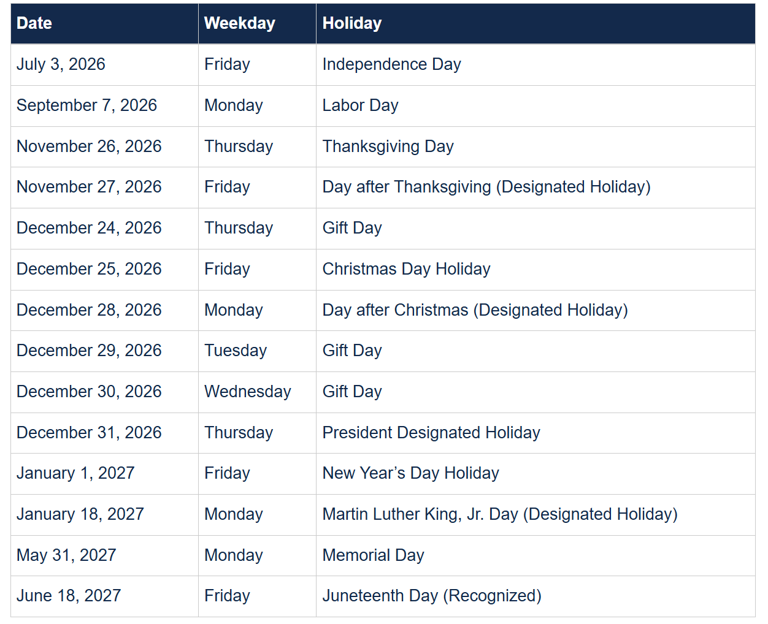
Campus Holiday Schedule 2026-2027

Slide 29
Important Information

Slide 30
Campus Resources
Annual Security Report at https://police.illinois.edu/clery/ (Campus crime statistics and campus security information
Campus Holiday Schedule at Campus Holiday Schedule - Illinois Human Resources
Campus Recreation at https://campusrec.illinois.edu
Shared Benefits Program at https://www.hr.uillinois.edu/leave/sharedbenefits/
Smoke-Free Campus Policy at https://tobaccofree.illinois.edu/
Obtain a University ID Card (Urbana ID Center, Illini Union Bookstore, First Floor, 809 S Wright Street, Champaign) Urbana ID Center, i-card Programs (uillinois.edu)
Establish parking arrangements if needed (Parking Department, 1201 W University Ave, Urbana, 217-333-3530) Web page: http://www.parking.illinois.edu Email: parkingcomments@illinois.edu
Research IT Portal Resources and Trainings https://researchit.illinois.edu/

Slide 31
Campus Resources (cont)
  Payroll Customer Service Office - Tax or pay questions: UIUC (217) 265-6363 or payinq@uillinois.edu
  Graduate College - Academic program/Tuition and fee waiver policies
  Office for Access & Equity (OAE): Addresses concerns about possible discrimination or harassment based on sex, gender, race, disability, or age.
  Enroll in Illini-Alert: All @illinois.edu emails are automatically enrolled; log in to http://emergency.illinois.edu to add a cell phone number for text alerts and a secondary email.
  For Emergencies: Call 911 from a campus phone, cell phone, or Teams; refer to the Campus Emergency Response Guide for additional guidance: https://www.police.illinois.edu/em/preparedness/emergency-response-guide/

Slide 32
Orientations
Each Fall, Spring and Summer, ISSS provides a separate orientation for International Undergrads and Graduates. If you have any questions, please contact International Student and Scholar Services via email isss-programs@illinois.edu.
First-Year Students Required Programming (and transfer students): https://newstudent.illinois.edu/orientation/expectedprogramming
2026 Graduate Assistant Employee Orientation Dates:
  Tuesday, September 1, 2026, from 3- 4:30pm via Zoom
  Thursday, September 3, 2026, from 9- 10:30am via Zoom
https://humanresources.illinois.edu/employee-experience/new-employee/onboarding/orientation/

Slide 33
Questions?
Welcome to the
University of Illinois!!!
Best wishes toward a
rewarding academic adventure!!!

