Slide 1

Graduate Employee Orientation
August 29, 2025
Human Resources
Mariah Redmon, Assistant Director of Human Resources
Dana McCool, Senior Human Resources Generalist
Meghan Yearta, Human Resources Generalist
07/18/2020

Slide 2
HR Presentation Overview
Employment Information
Compensation
Tuition Waivers
Healthcare & Benefits
Leaves
Other Important Information

Slide 3
Employment Information

Slide 4
What comes with an Assistantship?
Monthly stipend
Tuition and fee waivers
University pays 100% for coverage through McKinley Health Center and Counseling Center
Individual Health Insurance: The University will contribute 87% of the coverage
Dependent Health Insurance: The University will contribute 40% of the coverage
University paid dental and vision insurance coverage
Sick leave
Holidays
Notes:
Health Care- The University will contribute 87% per semester (fall, spring, summer) of the Student Health Insurance Fee for any assistant holding an assistantship who chooses to be covered by the University plan. The University will also cover 40% per semester of the cost of one dependent. Info found here: Contract — Graduate Employee's Union Organization at UIUC (uiucgeo.org)

Slide 5
Limitations to Employment
Non-resident Aliens can hold
  Up to 50% appointment during the AY
  Up to 67% appointment during breaks if enrolled in classes, 100% if not
US citizens/Permanent Residents/EAD can hold
  Up to 67% during the AY. Note: The Graduate College has raised its limit on concurrent employment for fellowship holders from 50% to 67%, and Grad Hourly positions will no longer count toward the limit. (Note, however, that any lower limits set by funders, departments, government agencies, etc. will still apply.)
  Up to 67% during breaks if enrolled in classes, 100% if not
Breaks (Fall, Winter, Spring)- Can be employed up to 100% regardless of above status. EXCEPTION: Summer - if a student is enrolled in classes – the maximum percentage is 67% (fellowships excluded)
Notes:
Foreign nationals cannot work over 50% - for any reason – this will jeopardize your visa status!
U.S. Citizens cannot work over 67% - for any reason
PR card holders cannot work over 67%
EAD cannot work over 67% - for any reason
Loss of tuition waiver

Slide 6
Tax Forms
U.S Citizens must fill out the W-4.
Non-Resident Aliens cannot fill out the W-4.
How to apply for a social security number (SSN): https://isss.illinois.edu/resources/apply_ssn.html
Contact the Social Security Administrative Office at https://www.ssa.gov/agency/contact/
Upon receipt of your SSN, please make a Tax Status Review appointment with Payroll. Additional information can be found here: Payments to Foreign Nationals - Business & Finance
Notes:
If this is not filled out you will not have the proper taxes withheld from your paycheck
If you are a Non-resident alien you CANNOT fill out the W-4 form. A tax information session will be available at a later date – an e-mail will be sent MUST HAVE SSN CARD FIRST

Slide 7
GEO
What is the GEO? The labor union that represents teaching and graduate assistants
  https://www.uiucgeo.org/
Employees are not required to join the union
Dues deduction determined by the GEO
More information can be obtained at the “all campus orientation”
Notes:
GEO is a union that represents the graduate assistant classifications of TA and GA
Employee: To perform duties as assigned, timely notification (14 days) if resigning or have conflicts in schedules, attend department/unit meetings, to communicate/plan with your supervisor any absences in advance (if possible)
Employer: provide access to office, lab, etc., mailbox if employed in unit, supplies to fulfill the duties of your job, to clearly state what duties you are assigned (although the dept may change the assignment of duties at their discretion – with notification to the employee)

Slide 8
Compensation

Slide 9
Stipend Payments
Must be paid via direct deposit
  New employees have 30 days to provide direct deposit information
  Failure to provide banking information results in pay being provided via paycard
My UI Info:
https://www.hr.uillinois.edu/myinfo
Pay Tab
Provide bank information for direct deposits
Access earnings statements
Provide tax withholding information (W-4) US citizens ONLY

Slide 10
Pay Dates
Pay dates are on the 16th of every month
  NOTE: Grad hourly appointments are paid Bi-weekly and must turn in a timesheet for payment
Appointment dates are 8/16/25 -5/15/26 for the academic year
Fall: Aug. 16, 2025 – Dec. 31, 2025
Spring: Jan. 1, 2026 – May 15, 2026
Assistantships are professional level appointments, percent time is not rigidly equivalent to hours/week
For example: 50% FTE assistant expected to provide an average of 20 hours/week over the course of the full appointment period
Notes:
Last pay check for fall appointment: Dec 16-31 (½ of month) will be paid out on 1/16 of the following year

Slide 11
Overtime Pay
Federal Labor Standards Act (FLSA) determines whether a position/employee is eligible to be paid overtime.
TA’s, RA’s, and PGA’s are FLSA exempt and therefore not eligible to receive overtime compensation
Administrative GA positions are FLSA non-exempt and eligible for overtime if more than 40 hours are worked in a single week
Required to keep record of actual hours worked

Slide 12
Tuition Waivers

Slide 13
What is included in a waiver?
Tuition waivers
  Certain curricula provide base-rate tuition only, student responsible for balance
  Additional waiver information can be found in the Graduate College Handbook (Chapter 7) at:
Handbook & Policies | The Graduate College at the University of Illinois at Urbana-Champaign
*If your appointment applies late, please contact financial aid at finaidwaivers@illinois.edu for information about the tuition waiver process
Notes:
Remember to reference Limitations to Employment

Slide 14
What is included in a waiver?
Fee Waivers
Academic Facilities Maintenance Fund Assessment (AFMFA) fee
Service fee
Library/ Information Technology fee
Transportation fee
International Student Fee
Notes:
Fee waiver information found here: Contract — Graduate Employee's Union Organization at UIUC (uiucgeo.org)

Slide 15
Tuition waiver processing schedule
Once the appointment is submitted in Banner there is a 2-3 day turnaround for the financial aid disbursement
Contact the Bursar’s office with questions about the waiver processing
Notes:
Remember to reference Limitations to Employment

Slide 16
Healthcare & Benefits Information

Slide 17
Health Care Information
McKinley Health Center
On-campus health center that provides a vast number of services including acute care, women's health, immunizations/vaccines, mental health services, primary care, and many others.
Scheduling Appointments: M-F 8AM- 5PM at 217.333.2700 or online MyMcKinley Portal
Fees/Dates/Deadlines: Health Service Fees, Dates, and Deadlines | McKinley Health Center | UIUC (illinois.edu)
Home | McKinley Health Center | UIUC (illinois.edu)

Slide 18
Health Care Information
Student Health Insurance
http://si.illinois.edu
May enroll dependents
Student Insurance Office
1109 S. Lincoln Ave. Urbana, IL (inside McKinley Health Center in the main lobby)
Dental & Vision
Assistants automatically enrolled
May enroll dependents
For more information and access to forms:
https://si.illinois.edu/benefits/dental-insurance-policy

Slide 19
Worker’s Compensation
Covered under the University’s plan
On the job, accidental injuries:
  Report the accidental injury to your supervisor
  Seek medical treatment
  Complete the injury report form

Slide 20
Leaves

Slide 21
Leaves
Paid Sick leave
Maximum 13 non-cumulative days per year
6 ½ days per semester
Days are equal to your “work day” and not set at 8 hours
Example: 33% appointment of 13.2 hrs/wk = sick day of 2.64 hours
Tracked by supervisors/units

Slide 22
Leaves
Parental Leave
6 weeks of paid leave immediately following birth or adoption
Leave shall not exceed 6 weeks in total
Available to both mothers and fathers
Must occur during active appointment period
Notes:
Parental Rights- Eligible TAs and GAs are entitled to six weeks of paid parental leave following the birth or adoption of a child. An assistant is eligible if s/he holds an active appointment at the time the leave is taken: Contract — Graduate Employee's Union Organization at UIUC (uiucgeo.org)

Slide 23
Leaves
Funeral/Bereavement Leave
Up to 5 days paid leave upon death of:
Immediate family
Domestic partner
Civil union partner
Household member
In-laws
Grandparents and/or grandchildren
1 day paid leave upon death of:
Relative other than the above who is not a member of employee’s household
https://www.hr.uillinois.edu/cms/One.aspx?portalId=4292&pageId=5623#Other%20Provisions
Notes:
Employment Leaves- Assistants are eligible for holidays, sick leave, parental, and bereavement leave. Review the Illinois Human Resources website for additional information. Questions about leave policies should be directed to Illinois Human Resources: chrome-extension://efaidnbmnnnibpcajpcglclefindmkaj/https://grad.illinois.edu/sites/grad.illinois.edu/files/pdfs/handbook.pdf

Slide 24
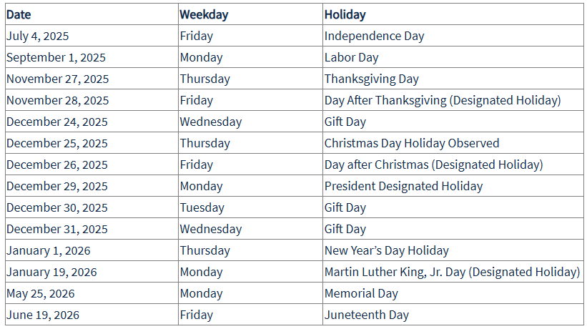
Campus Holiday Schedule 2025-2026

Slide 25
Important Information

Slide 26
Campus Resources
Annual Security Report at https://police.illinois.edu/clery/ (Campus crime statistics and campus security information
Campus Holiday Schedule at Campus Holiday Schedule - Illinois Human Resources
Campus Recreation at https://campusrec.illinois.edu
Shared Benefits Program at https://www.hr.uillinois.edu/leave/sharedbenefits/
Smoke-Free Campus Policy at https://tobaccofree.illinois.edu/
Obtain a University ID Card (Urbana ID Center, Illini Union Bookstore, First Floor, 809 S Wright Street, Champaign) Urbana ID Center, i-card Programs (uillinois.edu)
Establish parking arrangements if needed (Parking Department, 1201 W University Ave, Urbana, 217-333-3530) Web page: http://www.parking.illinois.edu Email: parkingcomments@illinois.edu

Slide 27
Orientations
Each Fall, Spring and Summer, ISSS provides a separate orientation for International Undergrads and Graduates. If you have any questions, please contact International Student and Scholar Services via email isss-programs@illinois.edu.
First-Year Students Required Programming (and transfer students): https://newstudent.illinois.edu/orientation/expectedprogramming
2025 Graduate Assistant Employee Orientation Dates:
Tuesday, September 2, 2025, from 3- 4:30pm via Zoom
Thursday, September 4, 2025, from 9- 10:30am via Zoom
https://humanresources.illinois.edu/employee-experience/new-employee/onboarding/orientation/

Slide 28
Questions?
Welcome to the
University of Illinois!!!
Best wishes toward a
rewarding academic adventure!!!

