Slide 1
SLCL New EO Orientation August 30, 2024
Communications Office
Dania De La Hoya Rojas, communications coordinator

Slide 2
Overall Communications Goal
To support the school’s objectives:
Maintain its reputation as a leader in cultural analysis, language, and linguistics
Establish the school as a model for intercultural competence
Aid in fostering a sense of community within the school and among campus affiliates
Find more ways to engage with alumni, promoting a sense of belonging and stewarding their support of the school
Help build new relationships and expand the school’s community by supporting student recruitment efforts in partnership with the College of LAS
SCHOOL OF LITERATURES, CULTURES & LINGUISTICS | COLLEGE OF LIBERAL ARTS & SCIENCES

Slide 3
Audience breakdown
Prospective students
Current students
Faculty/staff
Alumni
Outside community
SCHOOL OF LITERATURES, CULTURES & LINGUISTICS | COLLEGE OF LIBERAL ARTS & SCIENCES

Slide 4
Areas of focus
Storytelling
Newsletters
Web content/updates
Social media
Event promotion
Point of contact for LAS collaborations
Resource for communications-related questions
SCHOOL OF LITERATURES, CULTURES & LINGUISTICS | COLLEGE OF LIBERAL ARTS & SCIENCES

Slide 5
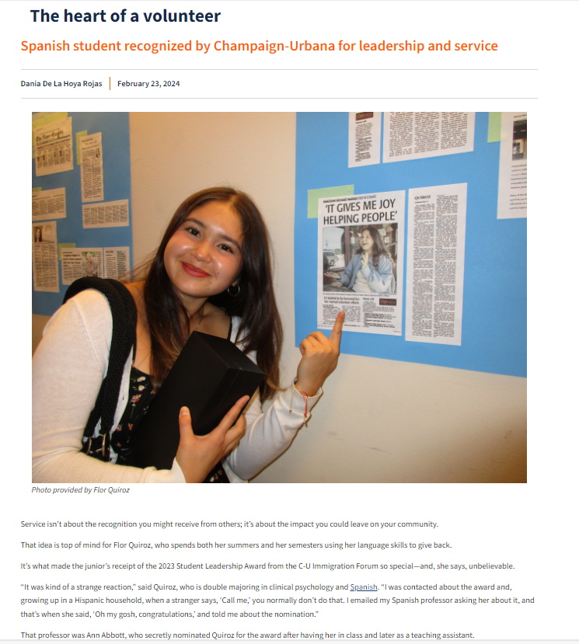
Storytelling to boost visibility for both SLCL and its units
Create content for all audiences
Represent all units as much as possible
Story pitch examples:
Alumni spotlights
Student spotlights
Staff spotlights
Major faculty accomplishments
Commentaries on newsworthy things happening in the community/country/world
Stories of overcoming hardship
Stories of making an impact
SCHOOL OF LITERATURES, CULTURES & LINGUISTICS | COLLEGE OF LIBERAL ARTS & SCIENCES

Slide 6
Newsletters
Print newsletter (once a year)
Roundup of most notable things that happened within SLCL that year
Sent once a year in early fall
Targeted to alumni but also goes to SLCL faculty, staff, graduate students, and affiliated units
E-newsletters (twice a semester)
Roundup of updates/news/deadlines
Sent in spring and fall
Separated by audience: internal (faculty/staff/graduate students) and external (alumni/donors)
SCHOOL OF LITERATURES, CULTURES & LINGUISTICS | COLLEGE OF LIBERAL ARTS & SCIENCES

Slide 7
Unit newsletters
SLCL communications and LAS can help units who would like to create a newsletter, but what that looks like is ultimately up to each unit
Units who do create their own newsletter should do so in dialogue with the school’s communicator to ensure the publication is consistent with LAS and campus guidelines
Since not all units will be able to work on their own newsletters, we aim to make the schoolwide newsletters as inclusive as possible. We give EOs a chance to give input on what goes into each newsletter and include them in the process
An email will be sent before each newsletter asking for suggestions; this is crucial in ensuring we can represent as many units as possible in each one
SCHOOL OF LITERATURES, CULTURES & LINGUISTICS | COLLEGE OF LIBERAL ARTS & SCIENCES

Slide 8
Web content and updates
SLCL communicator is responsible for updates to SLCL website
Can help units with troubleshooting and non-regular/larger updates, looping in LAS web team as needed
Some of the content that is created for the SLCL website (such as news stories) can also be used by units for their websites; we will alert units about stories involving their faculty/staff/students/alumni
SCHOOL OF LITERATURES, CULTURES & LINGUISTICS | COLLEGE OF LIBERAL ARTS & SCIENCES

Slide 9
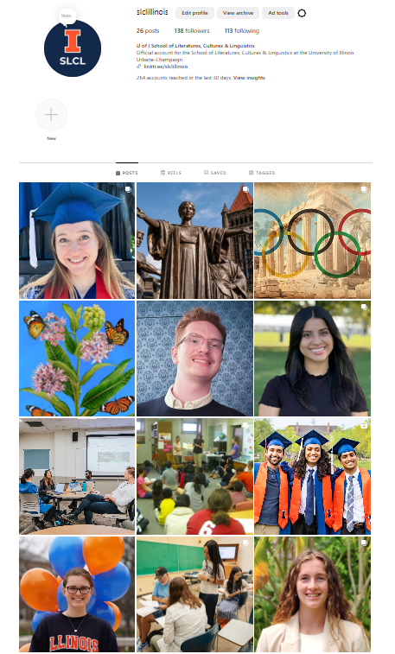
Building connections through social media
SLCL accounts: Facebook and Instagram (new)
Content for each platform determined by audience
News stories, announcements, events, campus life, etc.
Resources for social media: https://las.illinois.edu/faculty/communications/socialmedia
SCHOOL OF LITERATURES, CULTURES & LINGUISTICS | COLLEGE OF LIBERAL ARTS & SCIENCES

Slide 10
Event promotion
Calendars
SLCL communications coordinator manages schoolwide calendar
Flyers/posters
Template available for each unit; contact me if you need a copy
We can include event flyers on the digital monitor in the LCLB atrium if horizontal slide (1920x1080p) is provided
Happening at SLCL
Biweekly event/deadline bulletin
Sent every other Friday to faculty/staff and graduate student listservs
Events need to be added to unit calendars to be pulled or submitted via form
SCHOOL OF LITERATURES, CULTURES & LINGUISTICS | COLLEGE OF LIBERAL ARTS & SCIENCES

Slide 11
Collaborations + support
Point of contact for LAS collaborations
Website troubleshooting
Marketing materials for student recruitment
LAS “menu” with options like flyers, brochures, postcards, tabletop displays, swag and social media assets
Unit newsletters
Story pitches
Resource for communications-related questions: helping if its within my scope, or helping units connect with the right person/resource
Note: I’ll follow up with an email with the links + resources mentioned here and a few others that may be helpful.
SCHOOL OF LITERATURES, CULTURES & LINGUISTICS | COLLEGE OF LIBERAL ARTS & SCIENCES

Slide 12
Questions?
SCHOOL OF LITERATURES, CULTURES & LINGUISTICS | COLLEGE OF LIBERAL ARTS & SCIENCES

